Slide 1
Neural NEtworks
Przemysław Sekuła

Slide 2
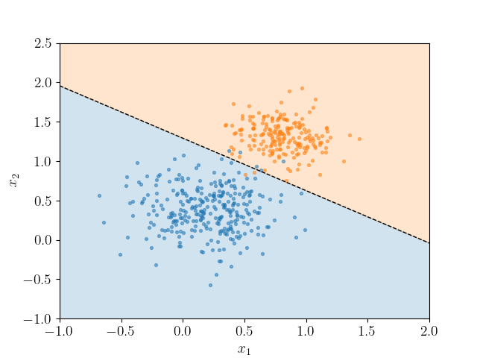
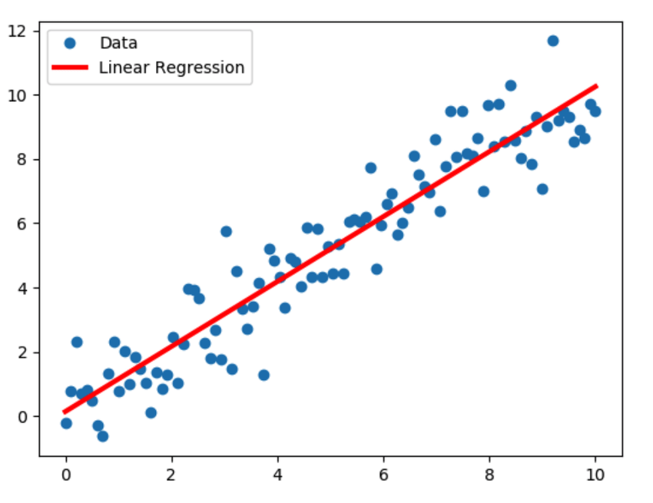
Linear and Logistic Regression
With linear and logistic regression we tried to map the inputs (features) on the outputs (labels).
To do this, we were using a simple linear function, and (for logistic regression) sigmoid nonlinearity

Slide 3
What if we need more advanced concepts…
price
affordability
taxes
awareness
demand
marketing
perceived quality
B
localization
A

Slide 4
Neural Networks - overview
price
taxes
demand
marketing
localization

Slide 5
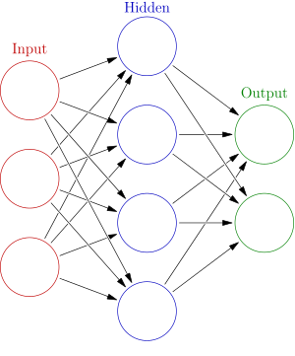
Neural NetworkS – WHY?
With neural networks you may generate much more complicated functions
We believe that it is possible to generate any function using a Neural Network…
… provided this network has enough neurons
The layers in neural networks are:
Input layer (just inputs)
Output layer (what do we want to predict)
Hidden layer (the layer between input and output)

Slide 6
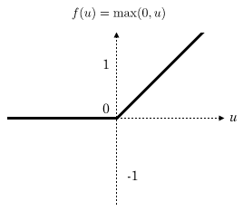
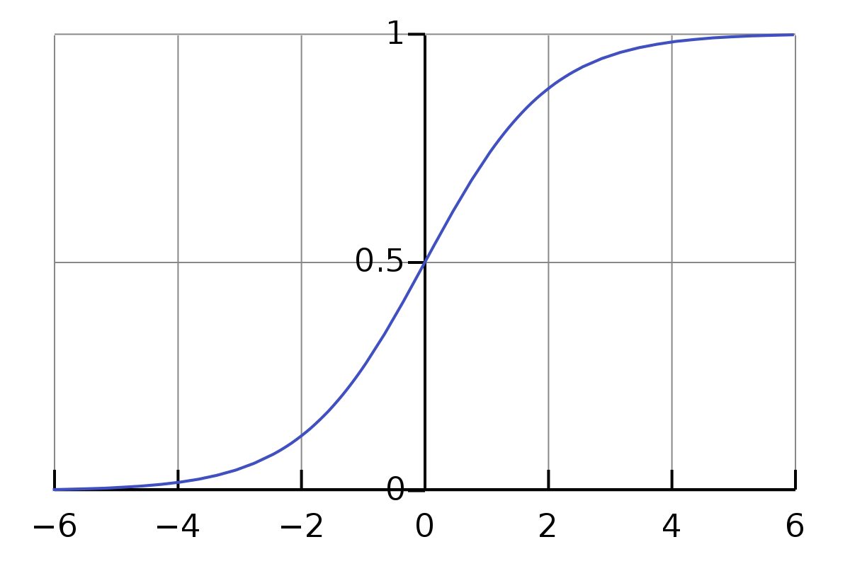
What’s going on in One Neuron
x₀=1
w₀
w₁
+
a
x₁
w₂
x₂
a=
g( )
w₀
w₁
x₁
w₂
x₂
+
+

Slide 7
What’s going on in One Neuron
x₀=1
w₀
w₁
+
a
x₁
w₂
x₂
a=
g( )
w₀
w₁
x₁
w₂
x₂
+
+

Slide 8
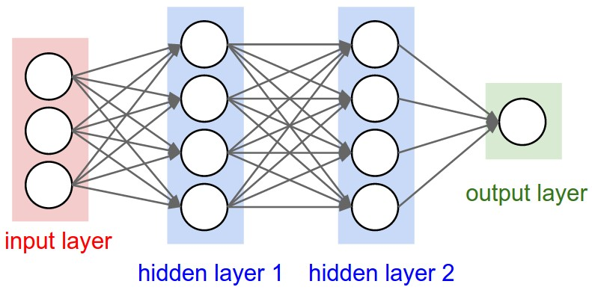
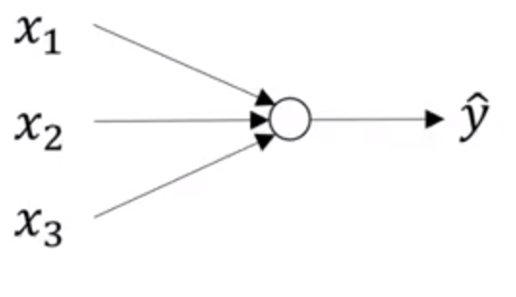
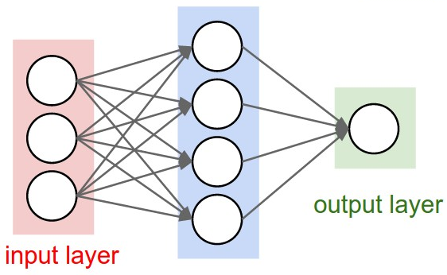
Deep Networks
Deep networks have more than 1 hidden layer

Slide 9

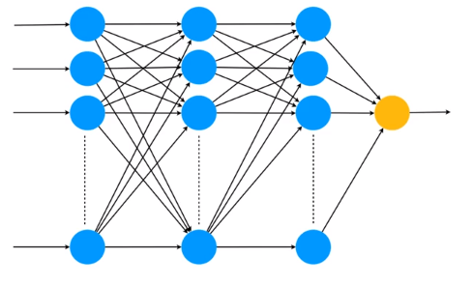
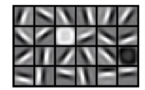
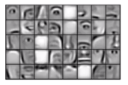
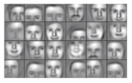
Why Deep networks?
Identity

Slide 10
Your Network Architecture
Basic idea:
If you want to extract more features use more neurons
If you want to extract more complex features use more layers
You must always think about overfitting – underfitting problem
You must experiment!

Slide 11
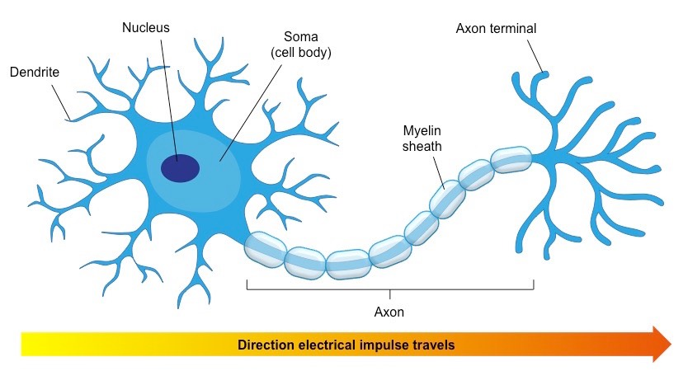
What does it HAVE To do with brain?

Slide 12

What does it HAVE To do with brain?

Slide 13
Thank you Q & A

